Slide 1
Homework 3

Slide 2
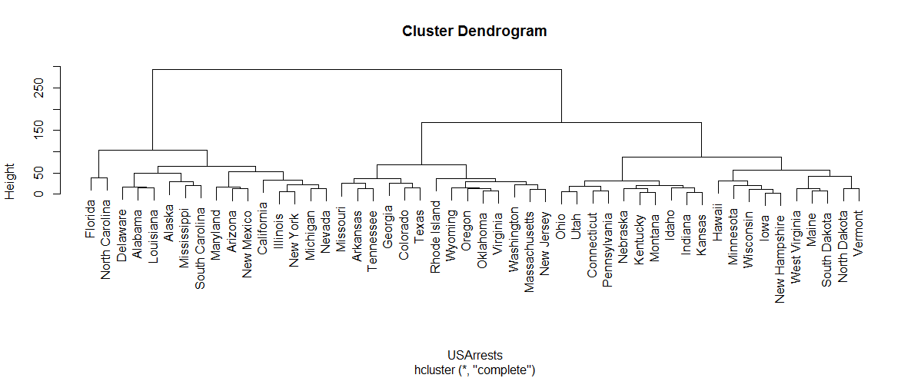
Homework 3
階層式分群演算法為資料分群的一種方法。階層式分群法的概念是在分群中建立分群，產生的分群結果為樹狀結構圖。
聚合式階層群聚法為一種階層式分群演算法，每次將距離最近的2個物件或分群進行合併(此距離定義為合併的高度(height))，直到變成一群為止。

Slide 3
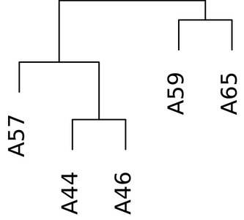
Homework 3
本次作業請利用Javascript寫一程式，自動找出與某個州小於某個距離的所有州
資料集
美國50州犯罪率的階層分群樹
相關資料已在hw3.js
距離定義
往上、下一層距離設為1
Example : distance(A57,A65) = 4
其他條件
Height 要小於50
3
2
4
1

Slide 4
Homework 3
變數說明
state:每州的名稱
共50筆資料
var state = ["Alabama","Alaska","Arizona","Arkansas","California","Colorado","Connecticut","Delaware","Florida","Georgia","Hawaii","Idaho","Illinois","Indiana","Iowa","Kansas","Kentucky","Louisiana","Maine","Maryland","Massachusetts","Michigan","Minnesota","Mississippi","Missouri","Montana","Nebraska","Nevada","NewHampshire","NewJersey","NewMexico","NewYork","NorthCarolina","NorthDakota","Ohio","Oklahoma","Oregon","Pennsylvania","RhodeIsland","SouthCarolina","SouthDakota","Tennessee","Texas","Utah","Vermont","Virginia","Washington","WestVirginia","Wisconsin","Wyoming"];

Slide 5
Homework 3
變數說明
height:每次合併時的距離
共49筆資料 (50州只需合併49次)
var height= [2.291288,3.834058,3.929377,6.236986,6.637771,7.355270,8.027453,8.537564,10.860018,11.456439,12.424975,12.614278,12.775367,13.044922,13.297368,13.349157,13.896043,14.501034,15.407790,15.454449,15.630099,15.890249,16.976749,18.264994,19.437592,19.904271,21.167192,22.366046,22.766642,24.894377,25.093027,28.635118,29.250641,31.477135,31.620405,32.718802,36.734861,36.847931,38.527912,41.487950,48.725148,53.593376,57.271022,64.993615,68.762272,87.326342,102.861557,168.611417,293.622751];

Slide 6
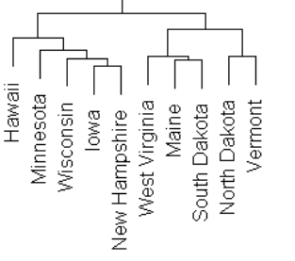
Homework 3
變數說明
merge:每次合併資訊
共49筆資料，每筆資料2個值 (50州只需合併49次，每次合併2物件或群)
var merge =[
[-15,-29],
[-17,-26],
[-14,-16],
[-13,-32],
[-35,-44],
[-36,-46],
[-7,-38],
[-19,-41],
[-49,1],
[-21,-30],
[-37,6],
[-4,-42],
[-48,8],
[-34,-45],
…
j< 0 , 第 -j 州在此階段被合併
第一階段:第15州(Iowa)與第29州(NewHampshire)合併
第二階段:第17州(Kentucky)與第26州(Montana)合併
…
第九階段:第49州(Wisconsin)與第一階段(15,29)合併
j> 0 , 代表合併第j階段
第i筆代表第i階段合併資訊

Slide 7
Homework 3
Input : (參考hw3.html)
距離
目標州
Output:
所有符合的州名
請按文字排序
中間用,分隔

Slide 8
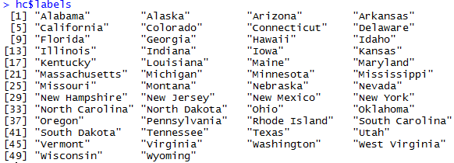
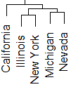
Homework 3
Example:
Case 1 :
Input :
4
New York
Output :
California, Illinois, Michigan, Nevada

Slide 9
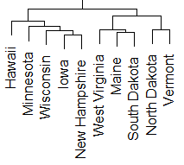
Homework 3
Example:
Case 2 :
Input :
5
Hawaii
Output :
Iowa, Minnesota, New Hampshire, Wisconsin
Height=57.27102

Slide 10
評分方式
共10題測資，每題10分
Bonus
前10%繳交且原始分數達90分
提供測試資料且有滿分的同學程式執行錯誤
tinin@saturn.yzu.edu.tw
標題: [1081Web] SID_HW3提供測資

Slide 11
Deadline
Deadline
12/19 23:59
繳交方式
上傳到portal
s學號_HW3.zip
s學號_HW3.html
S學號_HW3.js
檔名未依格式扣10%

